Slide 1

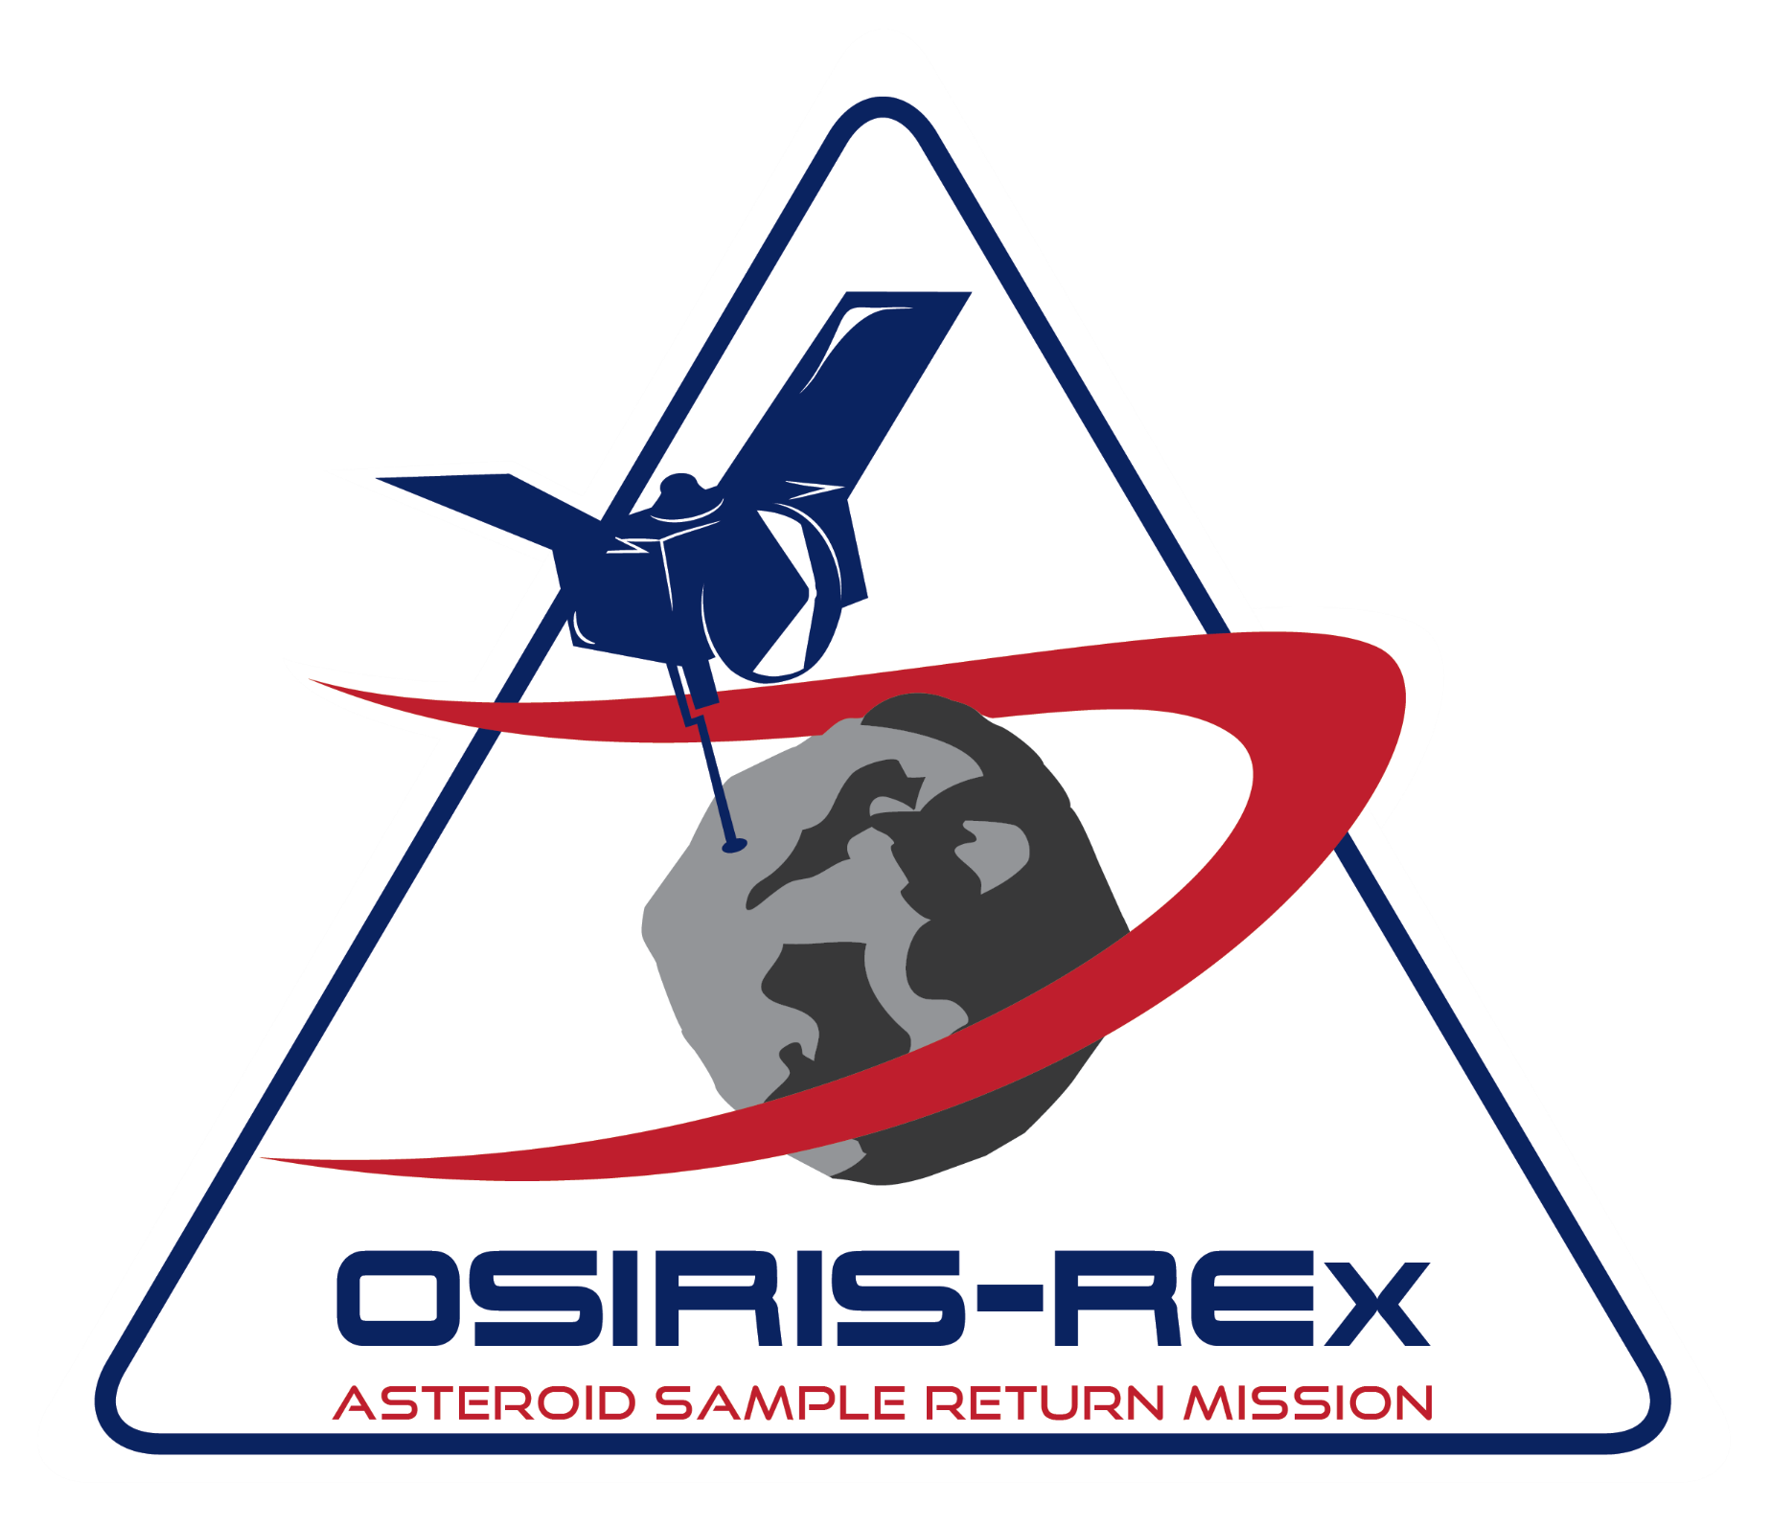
OSIRIS – REx Mission
Name: Anrieta Levi
I.D: 123456789
Department: The English Unit
Course: Advanced B
Lecturer: Anrieta Levi
Date: 13.1.26

Slide 2

Introduction
Origins Spectral Interpretation Resource Identification Security Regolith Explorer
Osiris - REx is NASA’s first asteroid sample return mission. [1]
OSIRIS-Rex’s objective - to travel to a near-Earth carbonaceous asteroid, study it in detail and return to Earth with a regolith sample. [2]

Slide 3
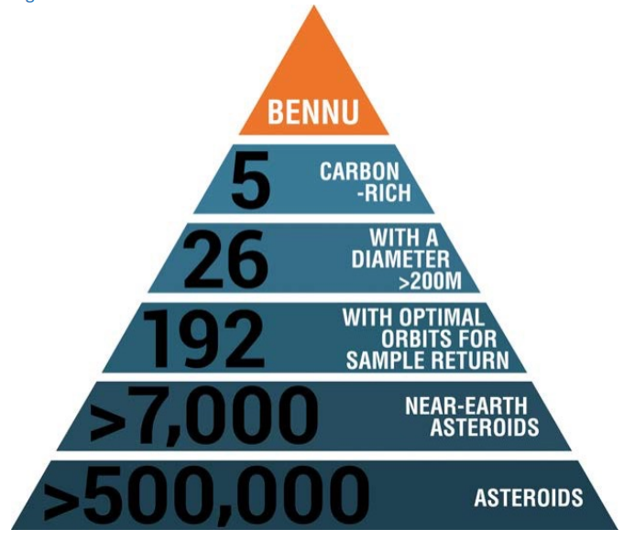
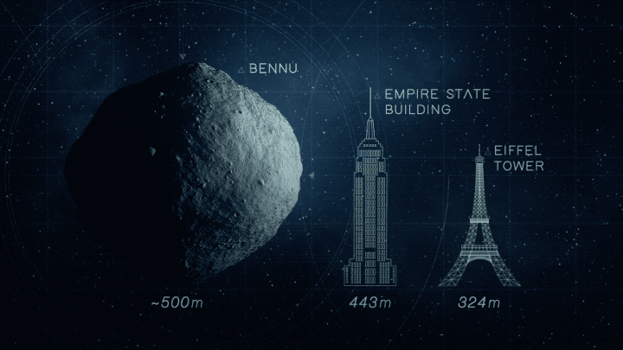
Bennu - the selected asteroid
Asteroids are geologic remnants from the early Solar System. [3]

Slide 4
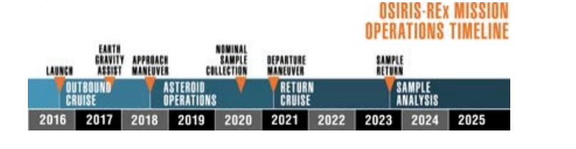

OSIRIS – REx Timeline [3]
8.9.2016
Cape Canaveral
20.10.2020
TAG maneuver
(Touch and Go)
23.9.2023
UTTR

Slide 5
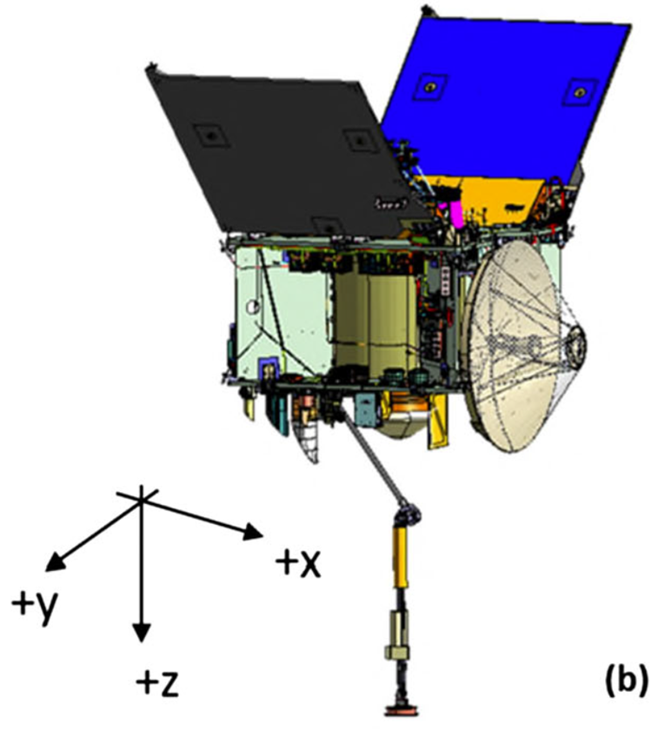
The Spacecraft [3]

Slide 6
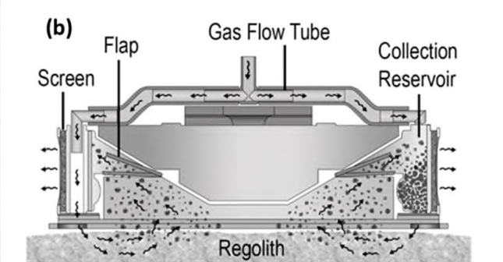
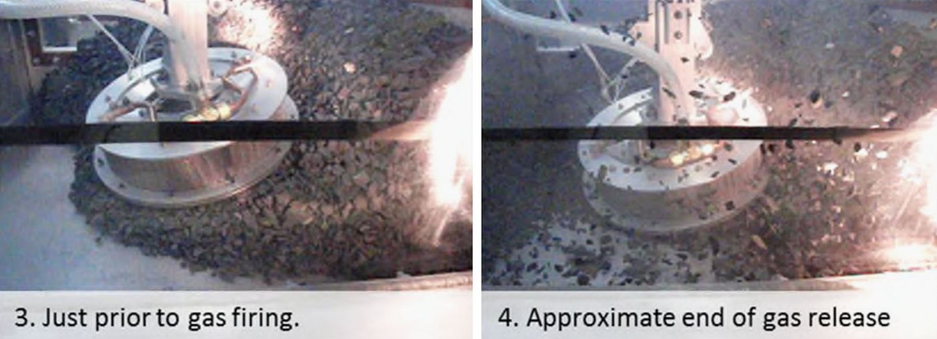
TAGSAM – Touch and Go Sample Acquisition Mechanism [1]
Duration = 5 sec.

Slide 7
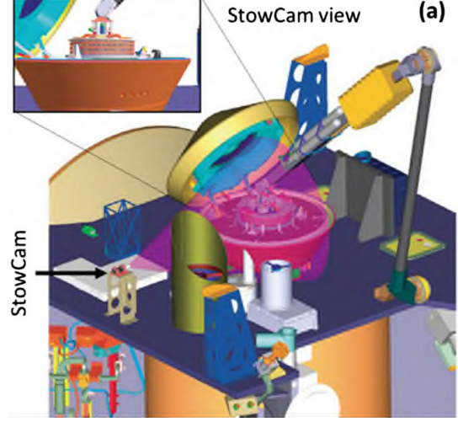
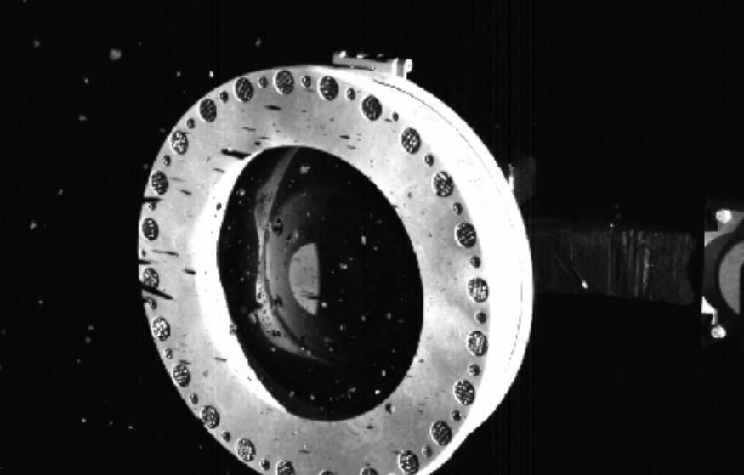
SRC – Sample Return Capsule [1], [4]

Slide 8
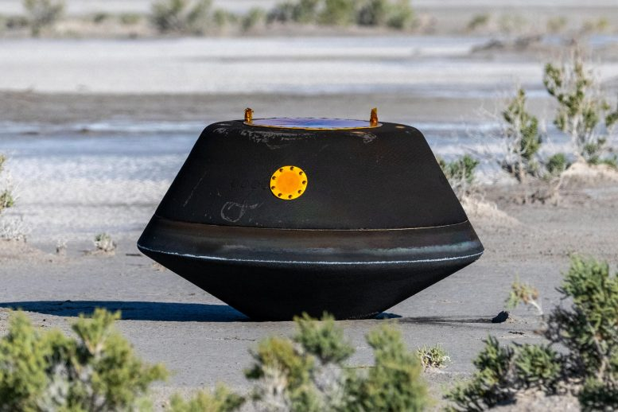
Summary and a Look to the Future
This sample will provide insight into the initial states of planet formation and the origin of life. [3]
Scientists will study a 1\4 of the regolith. 75% of the sample is reserved for study by future generations of scientists using new analysis techniques. [3]

Slide 9
Bibliography
[1] E. Bierhaus et al., “The OSIRIS-REx Spacecraft and the Touch-and-Go Sample Acquisition Mechanism (TAGSAM),” Space Science Reviews, vol. 214, no. 7, pp. 1–46, 2018.
[2] K. Berry et. al., "OSIRIS-REx Touch-And-Go (TAG) Mission," in 36th Annual AAS Guidance and Control Conference, Breckenridge, 2013.
[3] D. Lauretta et al., “OSIRIS-REx: Sample Return from Asteroid (101955) Bennu,” Space Science Reviews, vol. 212, no. 1–2, pp. 925–984, 2017.
[4] M. Wall, "NASA’s OSIRISREx Is Overflowing with Asteroid Samples," Scientific American, Oct. 26, 2020. [Online]. Available: https://www-scientificamerican-com.eu1.proxy.openathens.net//article/nasas-osiris-rex-is-overflowing-with-asteroid-samples/.[Accessed: Nov. 3, 2020]
[5] M. Wall, “Is Earth Safe from Asteroid Bennu?, “Scientific American” , Aug. 2, 2016. [Online]. Available: https://www.scientificamerican.com/article/is-earth-safe-from-asteroid-bennu/. [Accessed: Jul. 21, 2021]

Slide 10
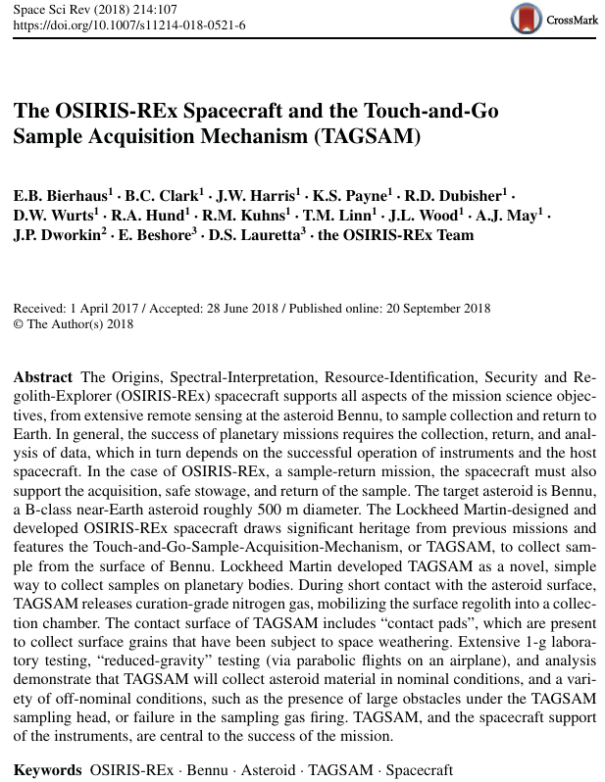
Oral Analysis Article
E. Bierhaus et al., “The OSIRIS-REx Spacecraft and the Touch-and-Go Sample Acquisition Mechanism (TAGSAM),” Space Science Reviews, vol. 214, no. 7, pp. 1–46, 2018.

Slide 11
Note to self: Show only if you have enough time left
https://www.youtube.com/watch?v=NjlGYHJ2560&feature=youtu.be
https://twitter.com/i/status/1319024328126664706

